Slide 1


Research Update
MESS and Rotor Scripts
Andres Cano
9/8/2021

Slide 2



What do we do, and how do we do it?*
Find accurate predictions for DoF frequencies, geometries and ground state/zero-point energies of molecules.
How?
Gaussian
Compare the above information for reactants and products in order to determine favoured reaction pathways
How?
MESS
*For computational work focusing on unimolecular reactions

Slide 3
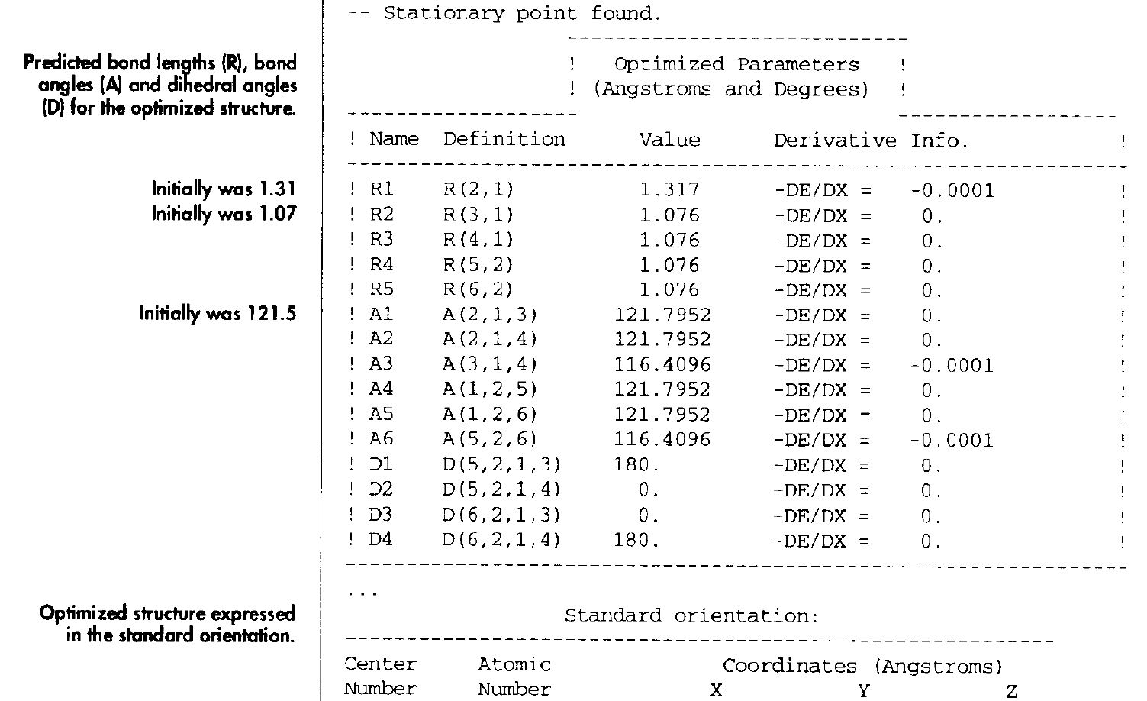
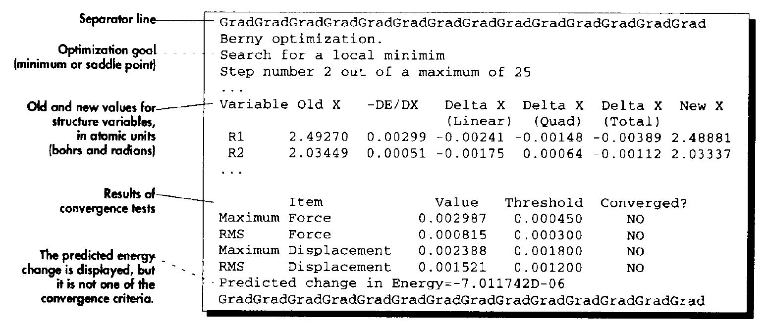
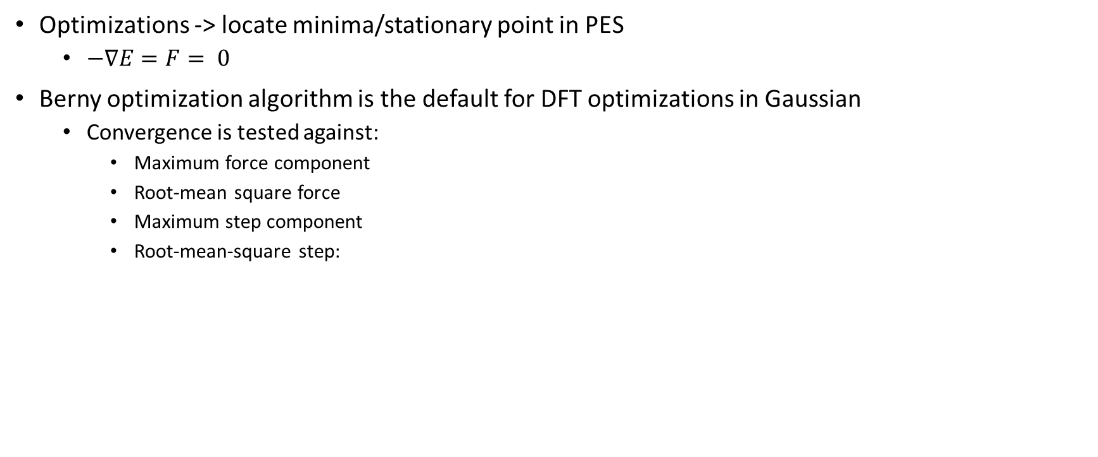
Gradient must meet certain thresholds to converge to a local minima
Optimizations -> locate minima/stationary point in PES
$−∇E=F= 0$
Berny optimization algorithm is the default for DFT optimizations in Gaussian
Convergence is tested against:
Maximum force component
Root-mean square force
Maximum step component
Root-mean-square step:
*Exploring Chemistry with Electronic Structure Methods
Notes:
Gradient of the potential (equal to force) is zero at the minima
Gradient indicates direction of most rapid energy decrease
Second derivative of energy is computed as well to determine the curvature and update the Hessian of force constants
Hessian is a matrix of second derivatives, used to describe local curvature of a multivariable function
Flat valley versus very steep regions. Example of how max force and step size compliment each other
RMS is a measure of the std dev of the residuals/prediction errors
After a stationary point is found, the optimized parameters will be shown under thresholds and Conv will say YES.
Opt params will be shown afterwards as well as the new xyz geometry

Slide 4
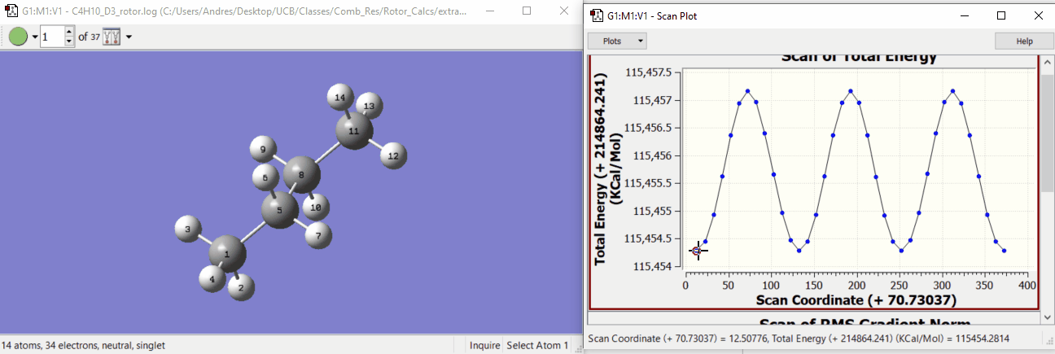
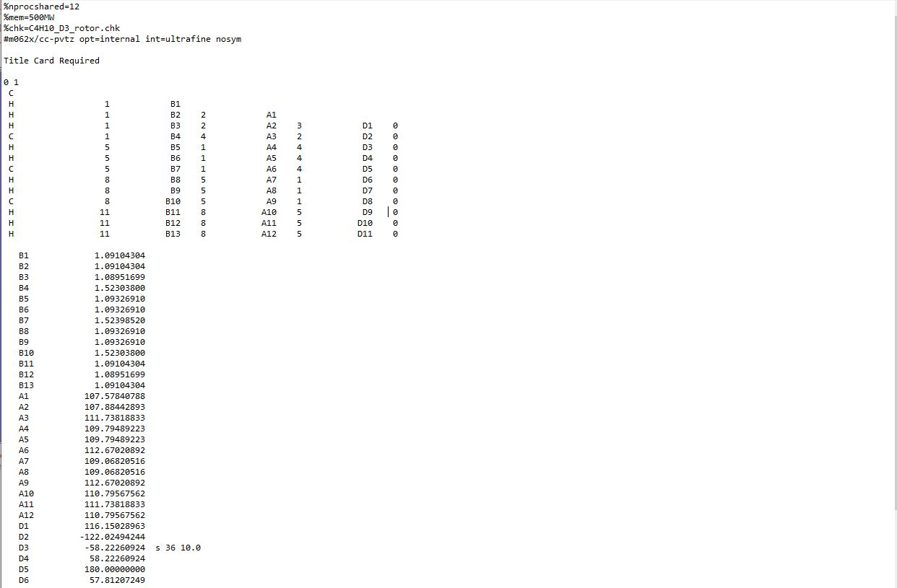
We want to scan the PES along all rotational degrees of freedom to potentially find a global minima
Number of steps and step size must be specified in order to scan along a PES in Gaussian
(6)
We want a way to automatically set up PES scans like this for all rotational degrees of freedom that help us find a global minima!
Notes:
Opt keyword is for a relaxed scan
First atom in dihedral descry is the one that moves
Restart
Restarts a PES scan calculation. A failed scan calculation may be restarted from its checkpoint file by simply repeating the route section of the original job, adding the Restart option to the Scan keyword. No other input is required

Slide 5
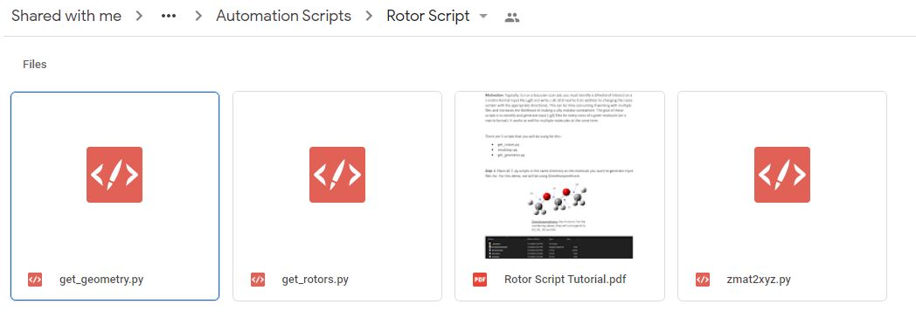
Rotor Scripts
Bulk of code, contains all the bond graph analysis, extracts rotors and dihedrals
Pulls rotor information from get_geometry.py and uses it to create copies and parse the scan command into new input files
Converts from Z-Matrix coordinates to (.xyz) Cartesian Coordinates
Notes:
There is a tutorial in the drive as well on how to use the code

Slide 6

TMP Chem (Trent M. Parker)!
A lot of the code is from TMP Chem:
Github: https://github.com/tmpchem
Youtube: https://www.youtube.com/user/TMPChem
Has an yt amazing series on Computational Chemistry!

Slide 7
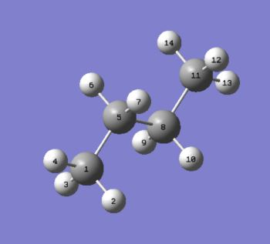
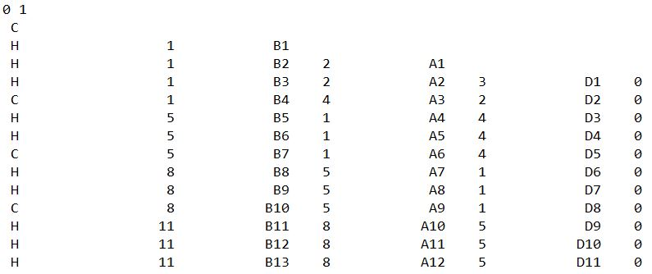
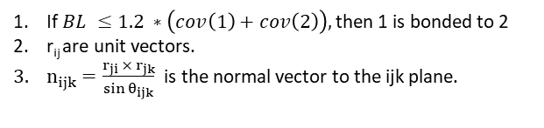
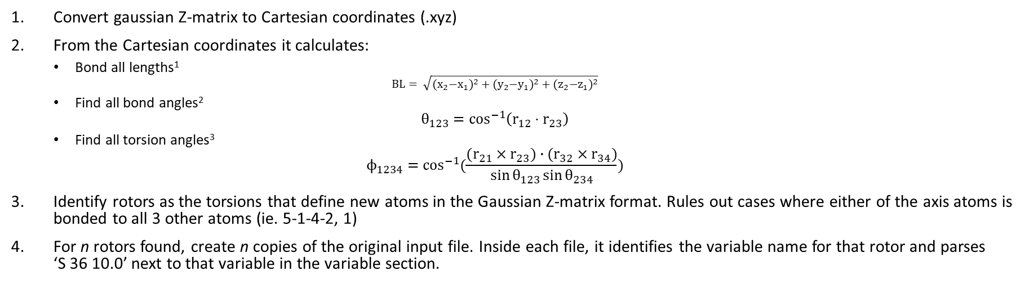
How does the code work?
Convert gaussian Z-matrix to Cartesian coordinates (.xyz)
From the Cartesian coordinates it calculates:
Bond all lengths¹
$$BL= \sqrt{{{(x}_{2}−x_{1})}^{2}+{{(y}_{2}−y_{1})}^{2}+{{(z}_{2}−z_{1})}^{2}}$$
Find all bond angles²
$$θ_{123}=\cos^{−1}\left(r_{12}⋅r_{23}\right)$$
Find all torsion angles³
$$ϕ_{1234}=\cos^{−1}{(\frac{(r_{21}×r_{23})∙(r_{32}×r_{34})}{\sin{θ_{123}}\sin{θ_{234}}})}$$
Identify rotors as the torsions that define new atoms in the Gaussian Z-matrix format. Rules out cases where either of the axis atoms is bonded to all 3 other atoms (ie. 5-1-4-2, 1)
For n rotors found, create n copies of the original input file. Inside each file, it identifies the variable name for that rotor and parses ‘S 36 10.0’ next to that variable in the variable section.
If $BL ≤1.2 ∗\left(cov\left(1\right)+cov\left(2\right)\right),$ then 1 is bonded to 2
r_{ij} are unit vectors.
$n_{ijk}=\frac{r_{ji} × r_{jk}}{\sin{θ_{ijk}}}$ is the normal vector to the ijk plane.

Slide 8
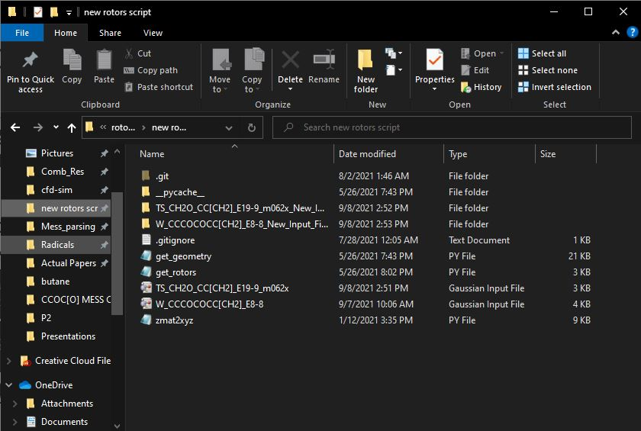
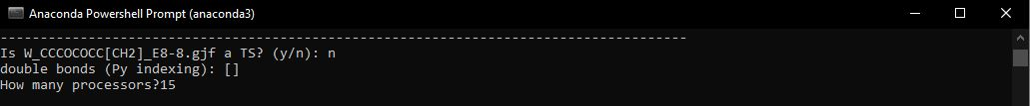
How do we run the code? (Inputs)
Place input (.gjf) file in the same directory as get_rotors.py, zmat2xyz.py, and get_geometry.py
Navigate to this directory in your terminal.
Call the get_rotors.py function:
>>python get_rotors.py
The code will return which bonds are identified as double bonds
update_header_gjf.py will be called for each file after specifying number of processors.

Slide 9
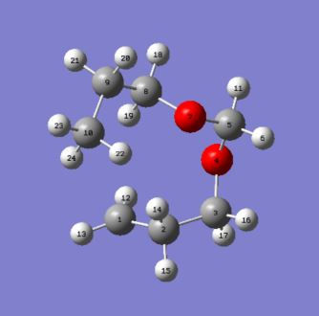
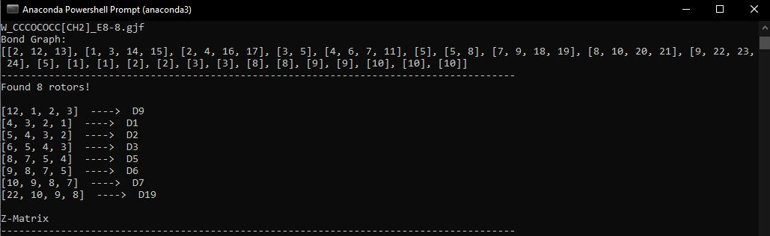
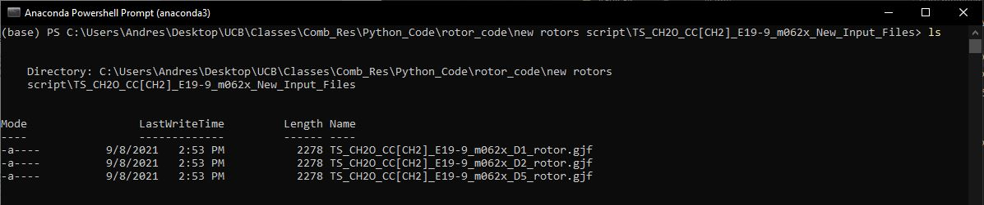
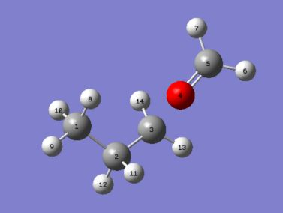
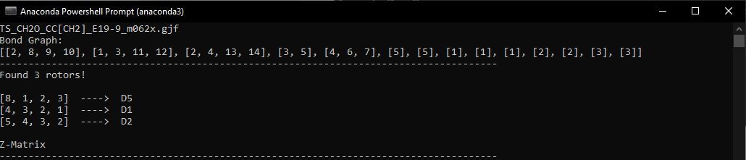
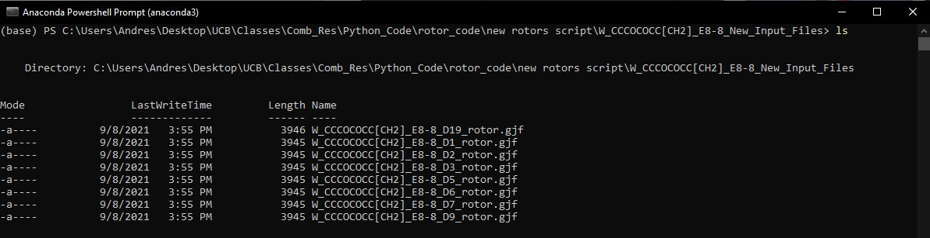
How do we run the code? (Inputs)
Notes:
Explain bond graph

Slide 10
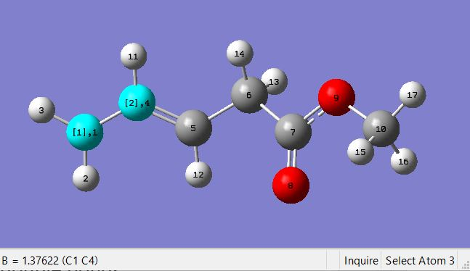
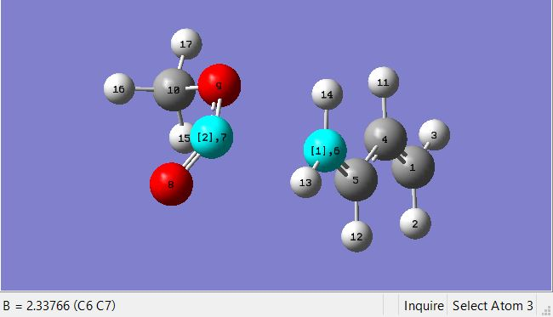
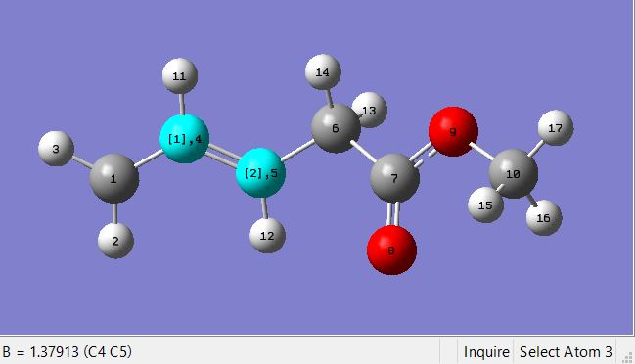
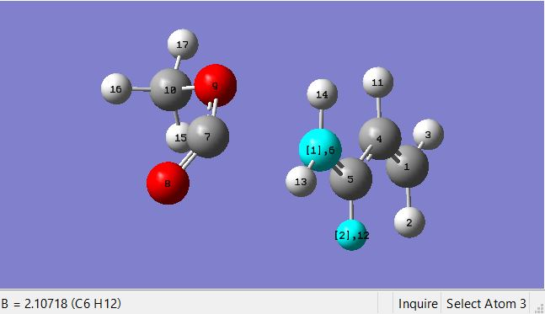
Bugs found so far
Mess code works off rotor code:
Single bonds having bond lengths shorted than double bonds
TS opt place atoms beyond threshold!
Shorter BL
Single bond
Shorter BL
Bonded
Longer BL
Double bond
Longer BL
Not bonded
Notes:
M-pentanol radical

Slide 11
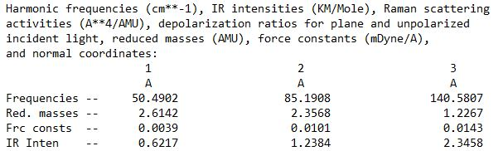
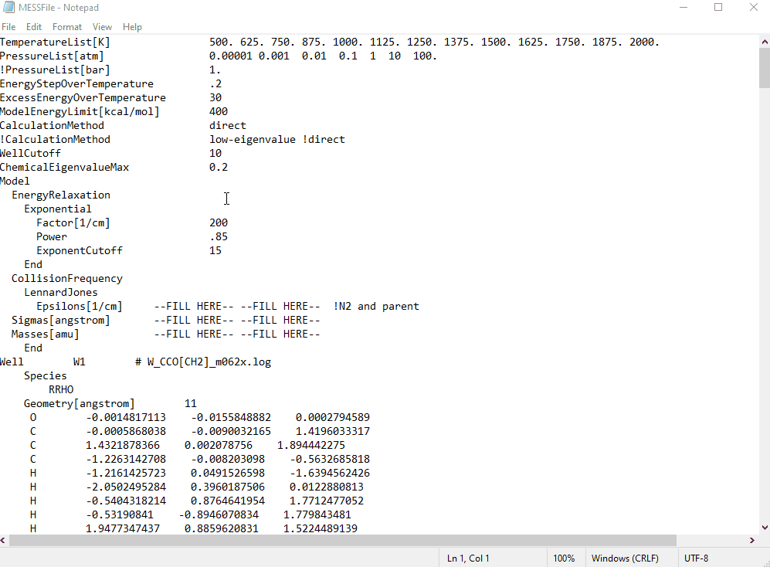
MESS needs frequencies, geometries and single-point energies in order to calculate rates of reaction
Where are the frequencies?
Where are the geometries?
Recall slide 3
Where are the energies?
CCSD(T) and T1 diagnostic used to extrapolate best approximation of ground state energy based on our methods.
Then…
We want a way to automatically set up most of the MESS File input structure given the frequencies, geometries and energies of the Gaussian output files!
Notes:
CCSD(T): coupled cluster theory – triple excitations –
Better energy approximation for stationary points (Once an accurate prediction of the PES global minima is found)

Slide 12
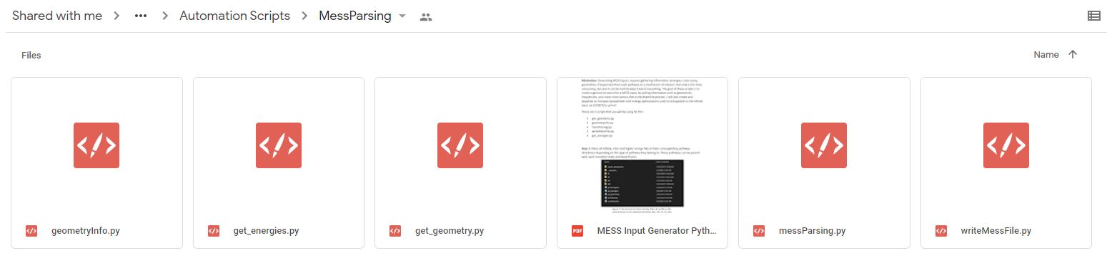
MESS Scripts
Pulls important functions from get_geometry.py used for writing the MESS input. (ie. Rotors for each molecule)
Pulls peak/valley energies from rotor scans and writes the extrapolation energies spreadsheet.
Bulk of code, contains all the bond graph analysis, extracts rotors and dihedrals
Contains all the functions that write the different sections of the MESS File.
Pulls topology functions from geometryInfo.py and writing functions from messParsing.py to build mess file.
Notes:
There is a tutorial in the drive as well on how to use the code

Slide 13
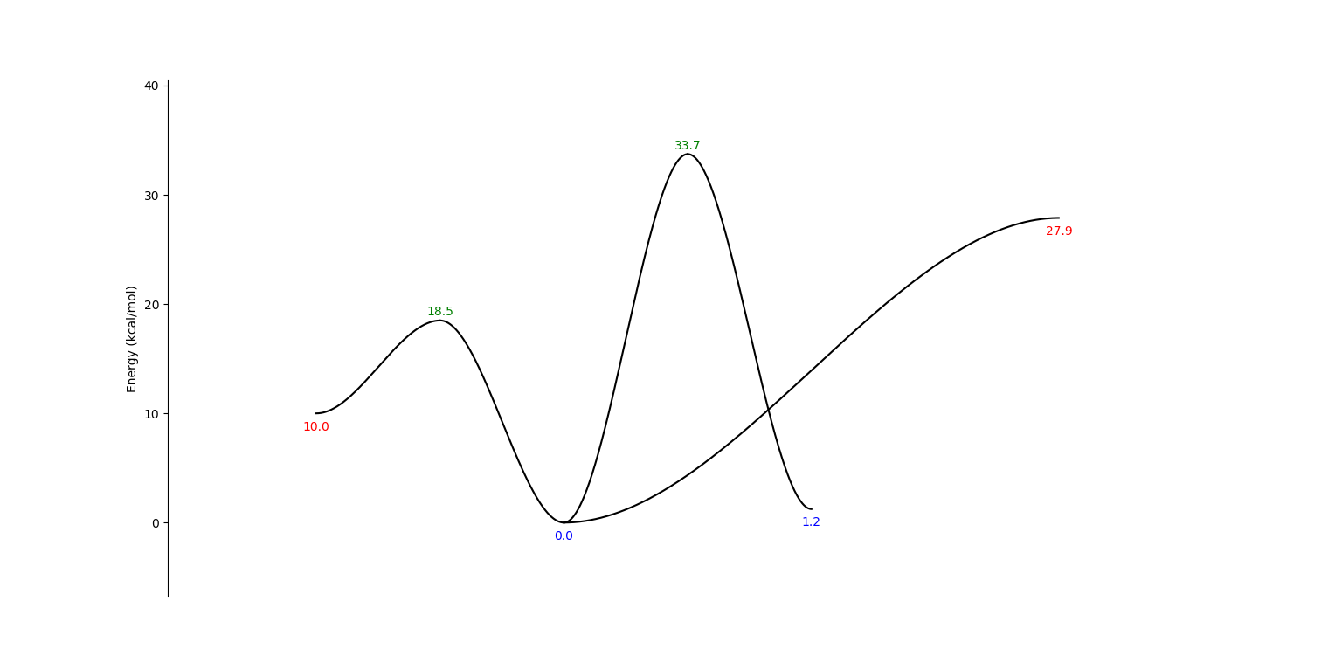
Identify Parent Well, Wells, Transition States, Bond Fissions
P2
Bond Fission
2 molecules
P1
Transition State
3 or more molecules
W1
1 molecule
W2
2 molecules

Slide 14
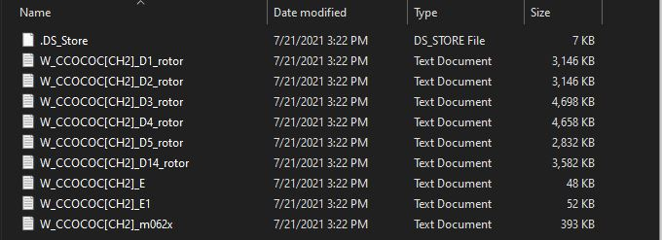
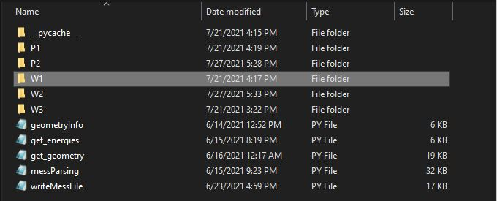
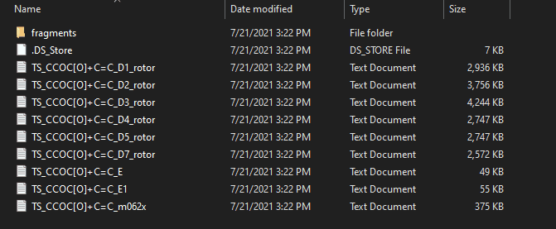
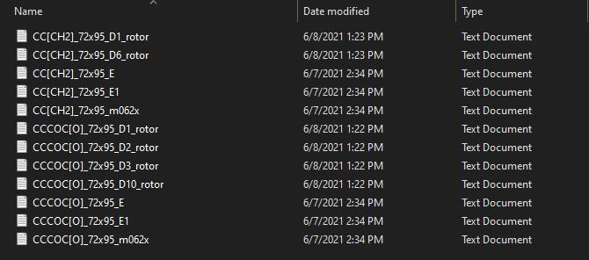
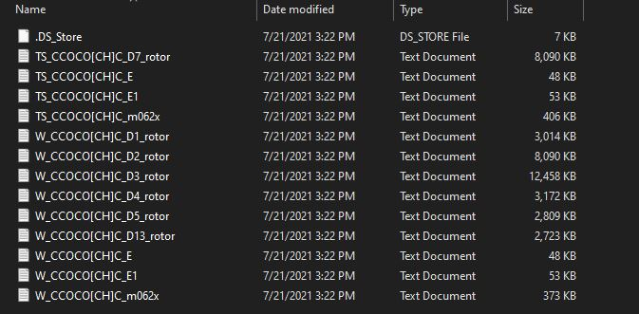
Arrange file structure and file naming
For Parent Well
For Transition States
For other Wells
For Bond Fissions
Notes:
Talk about naming _m062x is parent, E, E1, D#
Talk about BF and TS in P#
Talk about parent well must be W1
Talk about files must begin with W_ and TS_ if they are wells or TSs

Slide 15
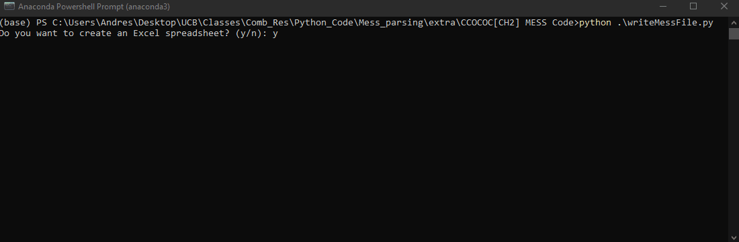
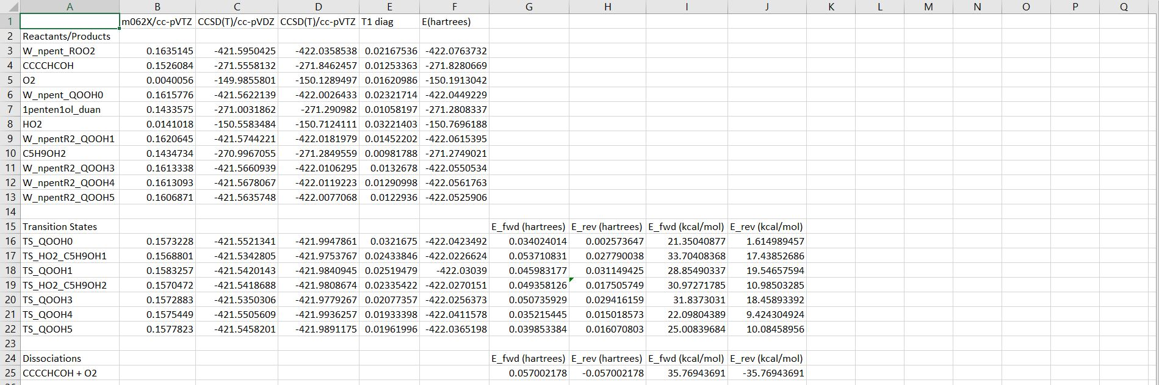
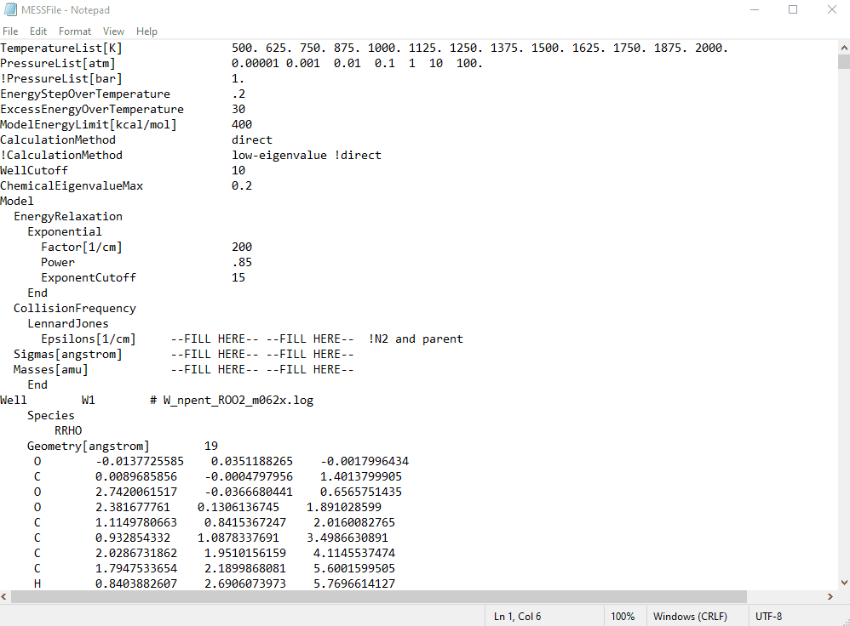
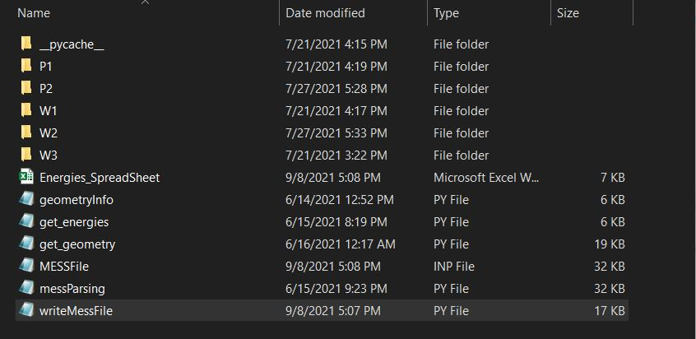
Once everything is arranged, run scripts from the terminal just like before!
Once you call >>python(3) writeMessFile.py you should see this.
Notes:
Talk about log outputs!

Slide 16
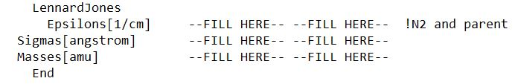
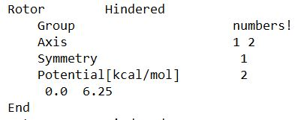
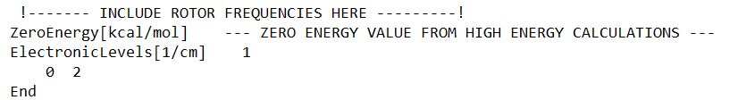
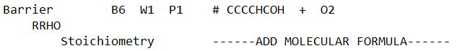
This is a MESS input structure only
It does not include:
Lennard Jones Parameters
Symmetry Factors
Rotor Groups
Rotational Frequencies
Relative Ground Energy values
Stoichiometric Formula
Phase Space Symmetry and Potential Prefactors
Notes:
I’m in the process of writing up all of the common errors I’ve gotten from the code for debugging
Code does not yet work for other reactions that don’t include the parent well

Slide 17


Thank you!

